Slide 1

International Initiatives American Association for Clinical Chemistry
Sponsored by the Wallace H. Coulter Foundation

Slide 2
“Better health through laboratory medicine”
About AACC
The American Association for Clinical Chemistry (AACC) is a global scientific and medical professional organization dedicated to clinical laboratory science and its application to healthcare.

Slide 3
International Initiatives
Global Lab Quality Initiative (GLQI)
Annual Scientific Meeting & Clinical Lab Expo
Membership Grants
Clinical Chemistry Trainee Council

Slide 4
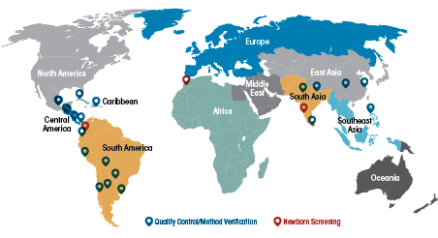
Global Lab Quality Initiative

Slide 5
GLQI Workshops
The program is generously funded by the Wallace H. Coulter Foundation
Since 2012, presented 23 workshops in 21 countries in the Latin America and Caribbean and Asia-Pacific region
AACC and WHCF, in conjunction with La Société Camerounaise de Biologie Clinique (SCBC, launched this first workshop in Africa

Slide 6
Africa Working Group
Committee Members
Dr. Olajumoke Oladipo (chair)
Dr. Brenda Suh-Lailam
Dr. Anne E. Tebo
Dr. Merih Tesfazghi
Consultants
Dr. Jeanette Guarner
Dr. Roa Harb
Dr. Jack H. Ladenson
Dr. Anthony Okorodudu

Slide 7
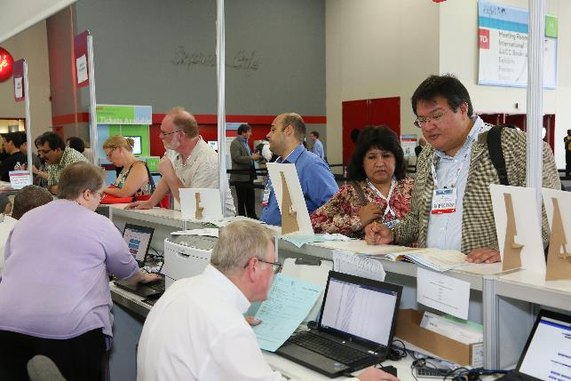
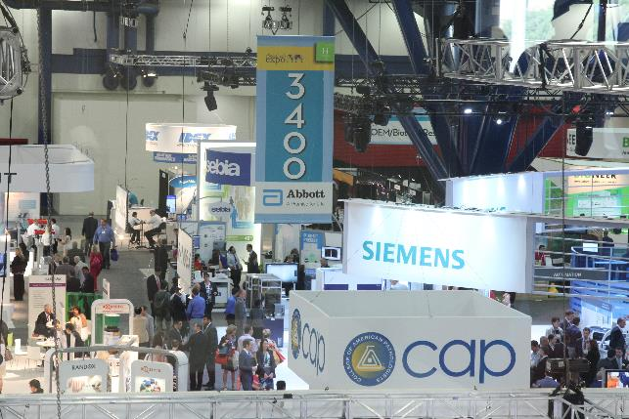
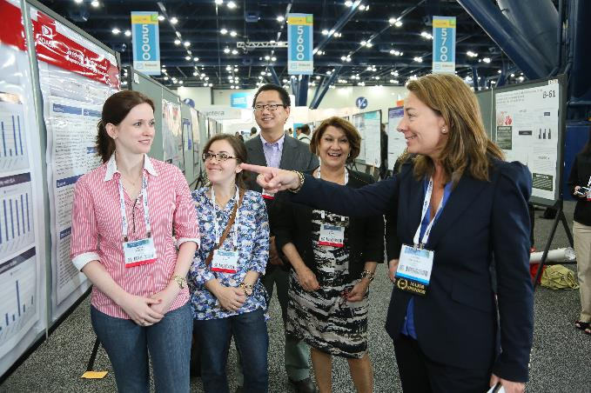

AACC Annual Scientific Meeting
International Initiatives

Slide 8
International Membership Grants
AACC's two-year professional membership scholarships are available to beginning and mid-career professionals from neglected areas worldwide.
Applications open in October of each year.
https://www.aacc.org/global-health-outreach/membership-grants

Slide 9

Register for free today! www.traineecouncil.org Materials available in French and English

Slide 10
Contact Information
international@aacc.org
Merci beaucoup!

