Slide 1
Pathologists Overseas
Presentation

Slide 2

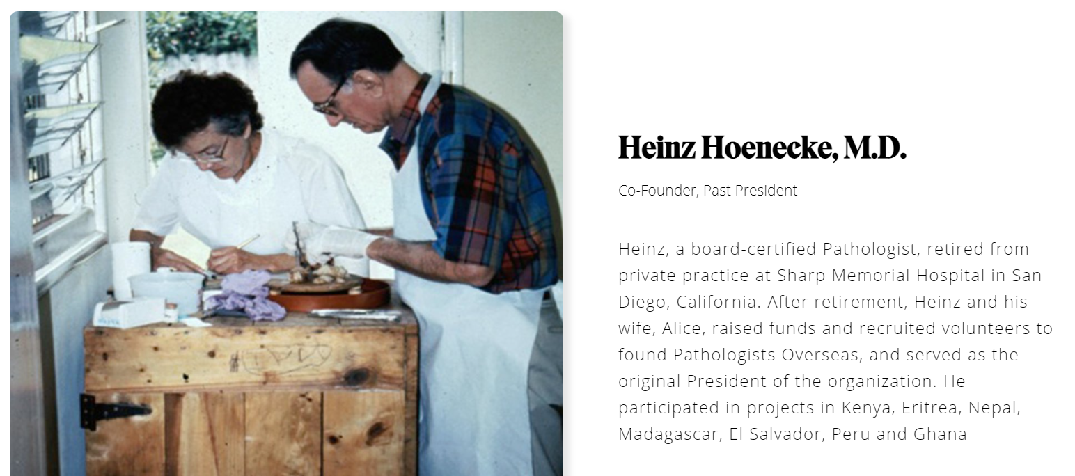
Pathologists Overseas is a Global community of Pathologists and Laboratorians founded by Heinz Hoenecke in 1991 with the mission to help develop or improve affordable, sustainable pathology and clinical laboratory services in developing countries through the efforts of volunteer pathologists, technologists and laboratory scientists.
Over the last 30 years we have worked in dozens of countries, supporting hundreds of labs and changing millions of lives.
Alice and Heinz Hoenecke
1991. Nairobi, Kenya

Slide 3
Previous Accomplishments
Laboratory Information Systems - Ethiopia (20 sites over 20 years), Eritrea (over 15 yrs), Malawi, Bhutan (8 laboratory and over 25 clinic sites for over 12 yrs), Nigeria (5 yrs)
Pathology and Laboratory Strengthening - Kenya (40 mission hospitals for 5 years), Peru, Malawi (Did all Histopath for 3 years while local Pathologists were in training), Uganda, Vietnam, Bhutan, Albania, Nigeria, Eritrea, Ethiopia, Zimbabwe, Haiti, and many more
External Quality Assurance programs - Bhutan (8 hospitals), Nigeria, Uganda (2 sites), Malawi (2 hospitals), Liberia, Peru, Eritrea (5 hospitals), Ethiopia. Some of these programs ongoing for over 15 years
Education - Eritrea, Zimbabwe, Malawi, Nigeria, Uganda and many others

Slide 4
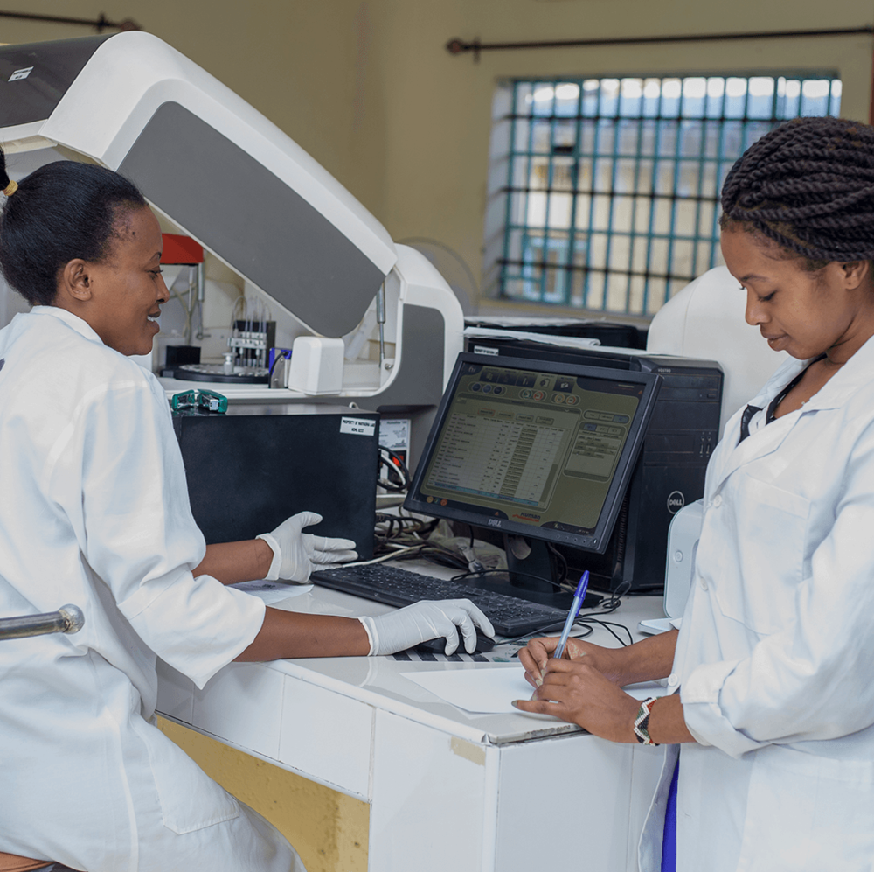
Current Projects

Slide 5
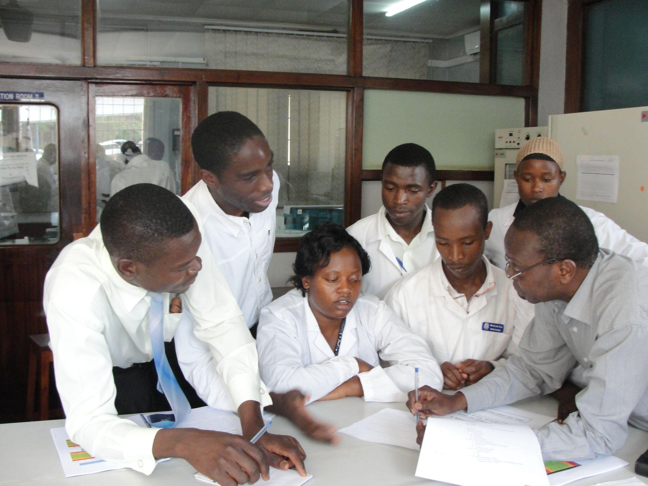
Education
Current and Future Courses
  LQMS (English, Spanish, French)
  LQMS problem-based learning groups
  LIS course
  EQA course
Opportunities:
  Lecture courses
  Participate in courses
Notes:
PO supports educational activities targeted at low-resourced settings. Our last virtual class had over 600 registrants from 24 countries: 87.5% from Africa.

Slide 6
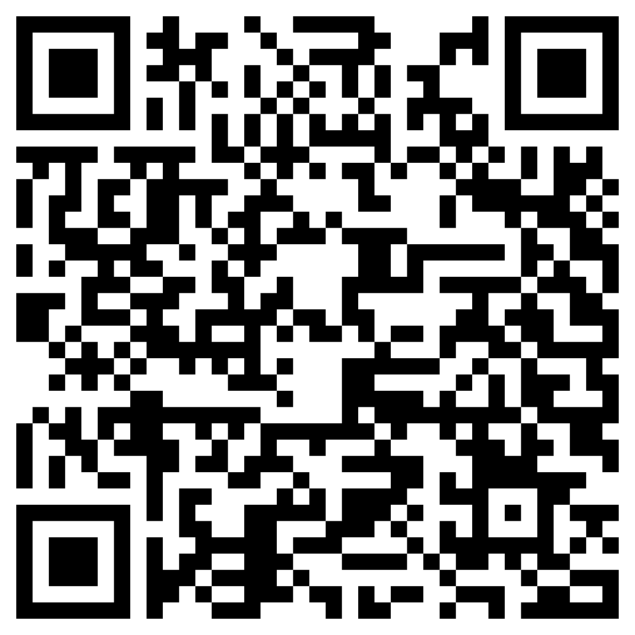
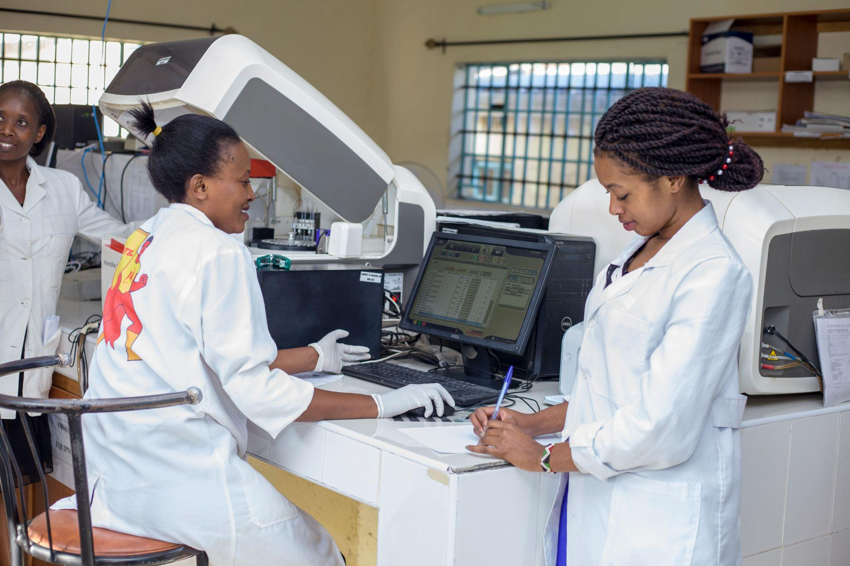
External Quality Assurance (EQA)
Interested in EQA?
Apply Here:
Current 6 Enrolled Labs in Nigeria, Malawi, Kenya
  Collaboration with RCPA QAP
Opportunities
  Accepting 3-5 new labs for EQA this year

Slide 7
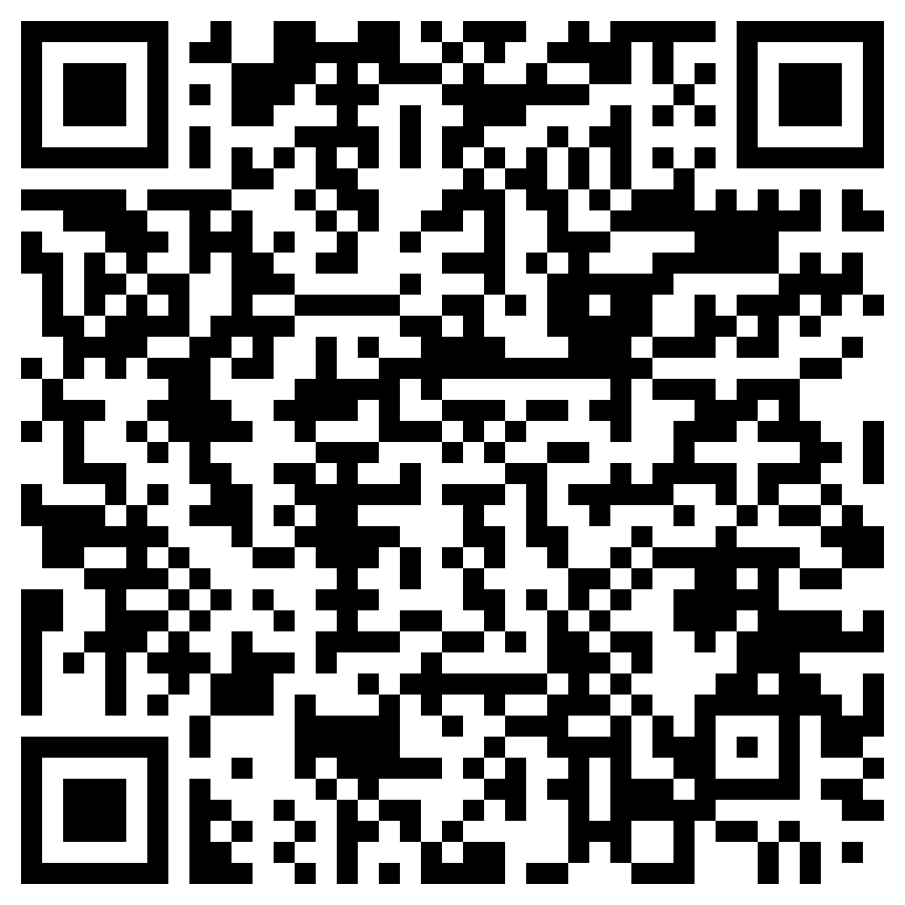
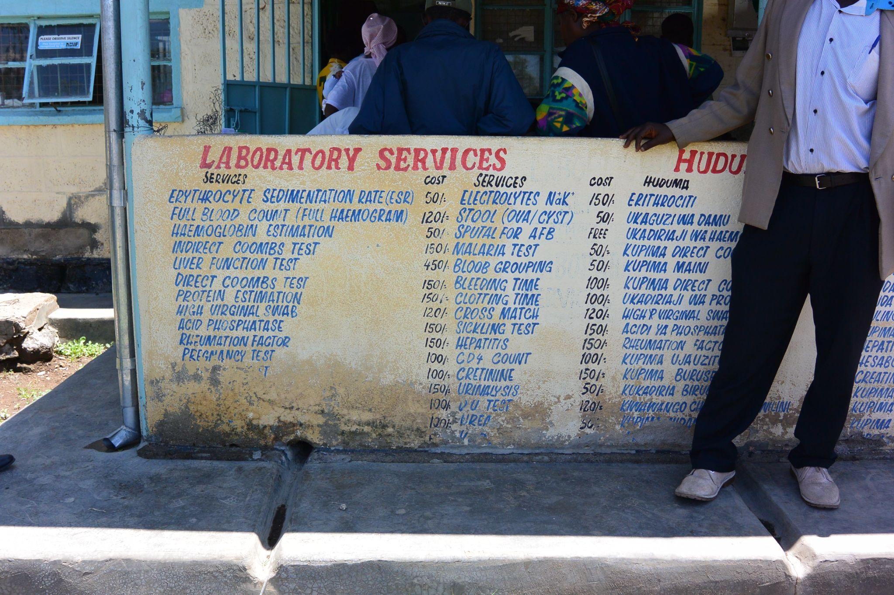
Laboratory Information System (LIS)
Interested in LIS?
Apply Here:
Active LIS projects in Nigeria
  Collaboration with Comp Pro Med
Opportunities
  Support LIS implementation for labs

Slide 8
Building a Global Community
Podcasts:
  Interviews with individual active in Global PALM
Lab Spotlights:
  A way to highlight the accomplishments of labs outside of the North America and Europe
Social Media:
  Twitter, Facebook, LinkedIn, Instagram

Slide 9




Existing external pathology partnerships
Heart to Heart International
Notes:
American Society for Clinical Pathology
Royal College of Pathologists of Australia
Bioventures for Global Health

Slide 10
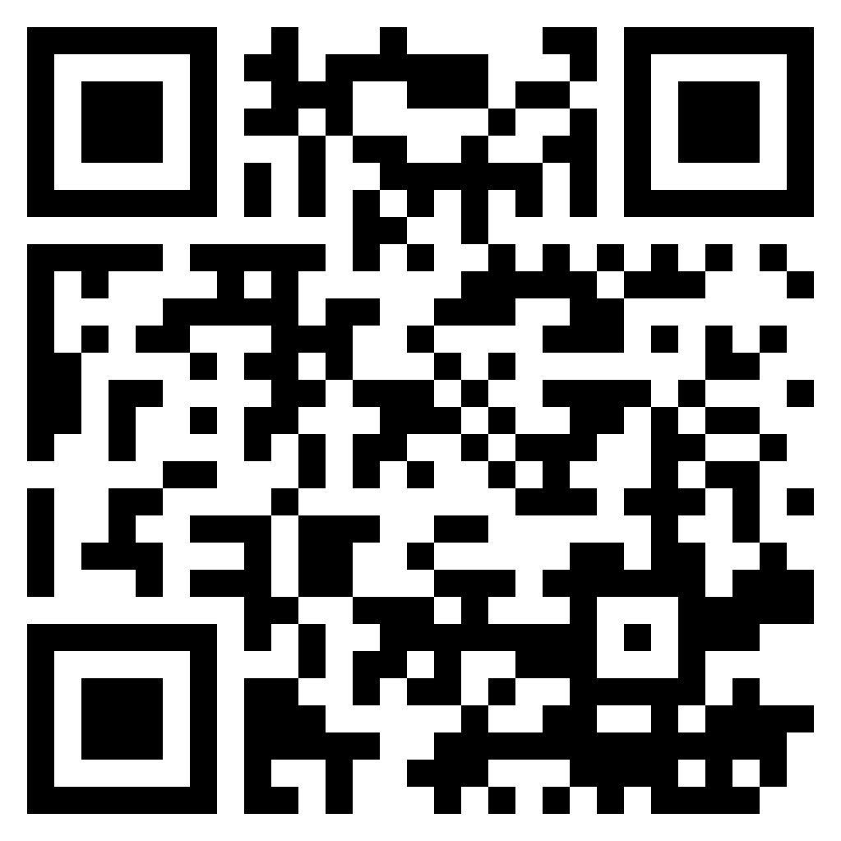

Find out more about
PO Programs Here:
Or Email us at admin@pathologistsoverseas.com

