Slide 1
Internal Quality Control Monitoring
Merih Tesfazghi, PhD, DABCC
Laboratory Director and Assistant Professor of Pathology, Rush Univeristy, Chicago IL
Laboratory Director, Johns Hopkins Clinical Research Project, Blantyre, Malawi
Co-Director, External Quality Assessment Program, Pathologists Overseas

Slide 2
Why should labs care about quality?
Laboratory is a service provider entity.
With service delivery comes customer.
Customer satisfaction defines the future of labs.
The question then is how “well” should labs serve.

Slide 3

What`s quality?
Quality is meeting customer needs
Philip Crosby
Four Absolutes of Quality Management
1979
Customer satisfaction is the minimum definition of quality
Notes:
Perhaps a simple way to define quality is meeting or exceeding customer needs. To meet or exceed customer need, the lab must characterize the customer`s need. Before we understand their needs, we need to first know who our customers are. Know your customers, understand their need, meet or exceed need. We are going to discuss this as we move forward but as we all know labs have a range of customers with perhaps with a range of needs.

Slide 4


Laboratory customers?
Laboratory
Public Health
Community
Patients
Physicians Health care
provider

Slide 5
Why should clinicians trust lab results?
Glu (Scenarios) | #s | Quality check | Reported results
Scenario 1 | 47 | Glycolysis | -
Scenario 2 | 99 | None | 99
Scenario 3 | 600 | Contamination | -
Scenario 4 | 147 | QC out | -
Scenario 5 | 990 | Entry error | -
Labs produce “numbers”
Quality makes those numbers “interpretable”
Interpretable results have clinical relevance, which leads to trust
Lab 1
Glu (Scenarios) | #s | Quality check | Reported results
Scenario 1 | 47 | Glycolysis | 47
Scenario 2 | 99 | None | 99
Scenario 3 | 600 | Contamination | 600
Scenario 4 | 147 | QC out | 147
Scenario 5 | 990 | Entry error | 990
Lab 2

Slide 6
Quality Management System (QMS)
Coordinated approach to direct and control activities of the laboratory
Everything a lab does to meet or exceed the needs and requirements of its clients
Quality control is a component of quality assessment in QMS, primarily designed to monitor analytical performance
Organization
Personnel
Equipment
Process Control
Purchasing & Inventory
Information Management
Assessment
Documents & Records
Occurrence Management
Process Improvement
Customer Service
Facilities & Safety

Slide 7
Quality control (QC)
Surrogate samples that are intended to simulate clinical samples from patients.
Monitors a measurement procedure to verify that a method continues to meet performance specifications.
QC monitors the analytical performance of an assay.
Does not monitor preanalytical testing phase
Does not monitor postanalytical testing phase

Slide 8
What do we need to consider when establishing a quality control system in our laboratories?

Slide 9
Mitigating risk of harm to patients
The primary goal of QC system is to mitigate the risk of harm to patients associated with reporting erroneous results.
Probability: How likely error occurs?
Severity: Degree of harm if error left undetected?
Detectability: How robust is the QC plan to detect error?

Slide 10
What does effective QC system entail?
1
QC material selection
2
QC target value and range
3
QC monitoring
4
QC frequency of analysis

Slide 11
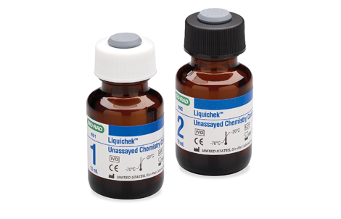
QC material selection
QC materials should be commutable.
QC concentrations should span AMR and clinical decision limits.
QC materials should be homogenous and stable.
QC material should have minimal vial-to-vial variabilities.
QC materials should have reasonable cost.

Slide 12
Commercial QC materials
QC materials made and supplied by the manufacturers
Optimized QCs for specific reagents or instruments
Not optimal to detect systemic error if formulation mimics calibrator
QC materials made by a third party for the manufacturers
Made based on specifications provided by the manufacturers
May not detect systemic error if formulation mimics calibrator
QC materials made by a third party independent of manufacturers
Made independently, not specific to instrument, reagent or calibrator
QC materials different from calibrators

Slide 13

Patient specimen QC samples
Specimen pool
Challenging to cover AMR and clinical decision limits
May require supplementing with purified materials
Pooling and supplementing may introduce matrix bias
Issue of stability for some measurands

Slide 14
Forms of QC materials
Lyophilized QC
Advantage: stable, longer shelf life, good for labs without freezers
Challenge: requires reconstitution – introduces variability
Liquid QC
Advantage: convenient – ready to use
Challenge: requires freezer
Assayed QC
Target and limit values provided by manufacturers
Unassayed QC
Target and limit values NOT provided by manufacturers

Slide 15
Global Survey: Types of QC materials commonly used?
(Global Survey by Westgard.com)

Slide 16

Effective QC monitoring
1
QC material selection
2
QC target value and range
3
QC monitoring
4
QC frequency of analysis

Slide 17

Appropriate QC target and acceptable range
Target value is an estimated mean concentrations of the QC obtained from a stable measurement system.
Range is a decision limit around the target value obtained from a stable measurement system.
2SD is commonly used to define ranges

Slide 18
Establishing QC target and range values
Labs should establish their own target values and ranges
Ideal target/range: 6-12 months data
Initial range: 20 days
Initial target: 10 days
Provisional target: < 10 days
Old QC lot ranges can also be used and monitored closely
Manufacturer provided target values and ranges can be temporarily used.

Slide 19
Global Survey: How do labs set QC limits?
(Global Survey by Westgard.com)

Slide 20
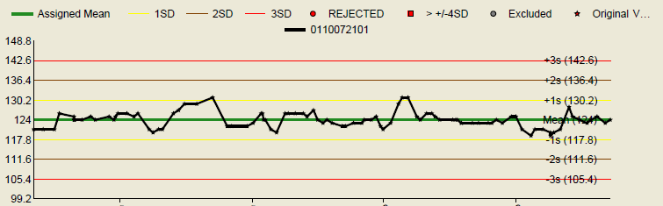
Scenario
Assume that following verification studies your laboratory began testing sodium on a new analyzer on Day 13. Immediately after this transition, clinicians noticed an increase in low sodium levels in otherwise clinically asymptomatic patients. A QC review of both levels did not reveal any apparent bias; however, further audit (pt results old vs new analyzers) confirmed an increase in low sodium with a median negative bias of 5 mmol/L. The root cause for the observed negative bias was identified and resolved.
4 admissions
Intervention interruptions
Care rescheduling
Patient experience
Cost

Slide 21
Effective QC monitoring
1
QC material selection
2
QC target value and range
3
QC monitoring
4
QC frequency of analysis

Slide 22
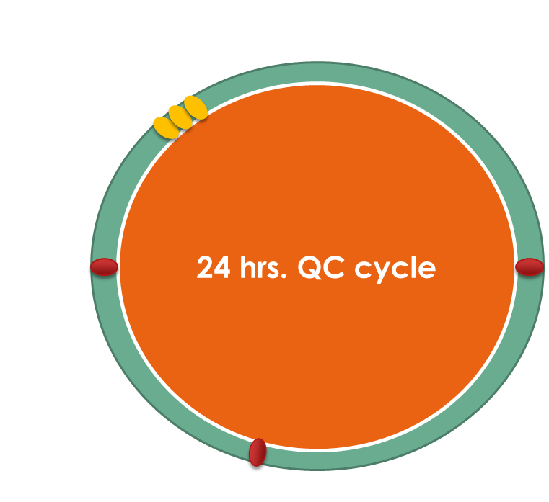
Frequency of QC analysis
In the US (CLIA regulation 493.126(d)(3), at least once each day.
QC levels
Quantitative: 2 levels
Qualitative: neg + pos
Major factors that determine QC frequency
Risk of reporting error
Time between QCs
Test volume between QCs
Decisions are made by the Lab Director

Slide 23
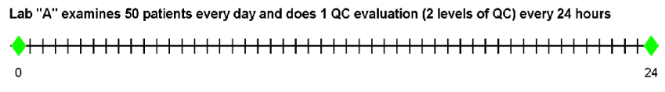
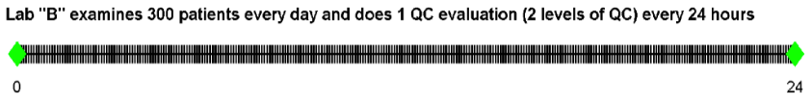
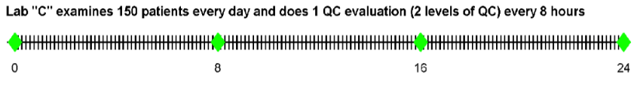
Frequency of QC analysis (Example)
https://www.qcnet.com/resources/qc-articles/the-frequency-of-quality-control-testing

Slide 24
Effective QC monitoring
1
QC material selection
2
QC target value and range
3
QC monitoring
4
QC frequency of analysis

Slide 25
Common QC monitoring Tools
Levey-Jennings (LJ) Chart
Westgard Rules

Slide 26
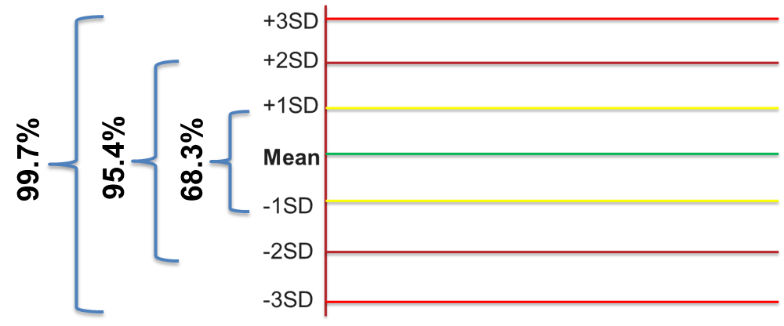
LJ chart
A repetitive analysis of QC samples produce a Gaussian distribution.
68% of results will be within + 1 s of the mean.
95.5% of results will be within + 2 s of the mean.
99.7% of results will be within + 3 s of the mean.

Slide 27
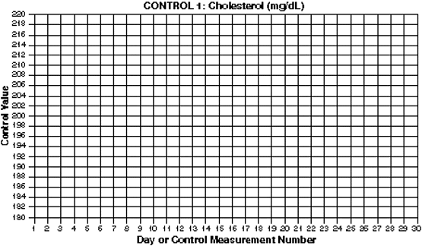
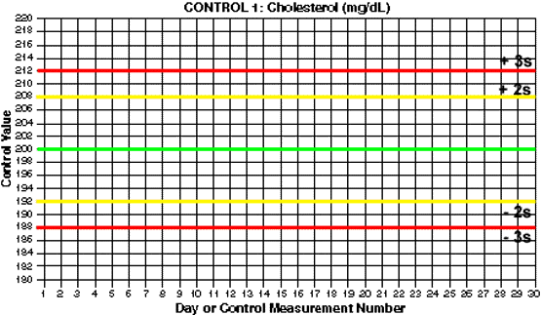
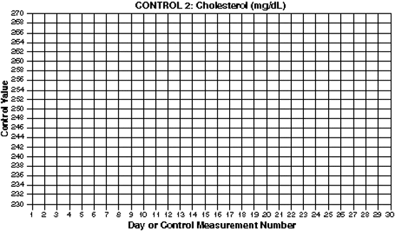
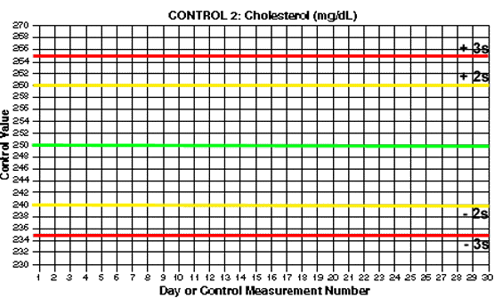
Manual preparation of LJ charts
https://www.westgard.com/lesson12.htm#4

Slide 28
Westgard rules notation
N_{S}
N= # observation that exceeds “S” from X
S= standard deviation
R_{S}
Range b/n two observations
S= standard deviation
Levey-Jennings (LJ) Chart
Westgard Rules

Slide 29


What are the outcomes of QC?
QC is either accepted or rejected
4 possible QC outcomes based on whether significant error was present and whether QC was “in” or “out”
Was there error? | Was QC out? | Outcome
No | No | True Accept
No | Yes | False Reject
Yes | No | False Accept
Yes | Yes | True Reject

Slide 30

Tradeoff between false and true alerts
QC review rules are tradeoff b/n true and false rejection.
Minimize false alerts
Maximize true error detection
Minimize harm to patients
False Error
True Error

Slide 31
Westgard rules (examples)
Rules | Definition | Applied | Meaning
1_{2s} | 1 QC result exceeds ± 2 SD | Within run | Warning
2_{2s} | 2 consecutive QC results exceed ± 2SD | Within/across run | Reject
1_{3s} | 1 QC result exceeds ±3SD | Within run | Reject
R_{4s} | 2 QC results span 4SD | Within run | Reject
4_{1s} | 4 results exceed 1 SD in the same direction | Within run/across | Reject
10_{x} | 10 consecutive QC results fall on one side of the mean | Within run | Reject

Slide 32
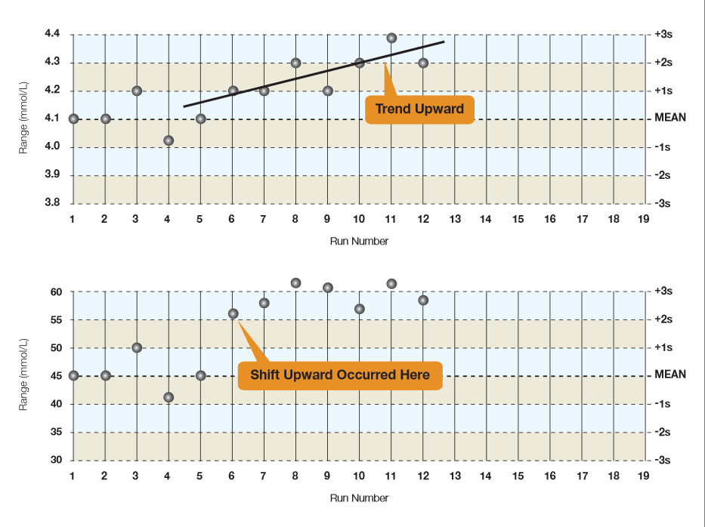
Shifts and Trends
Trend: gradual up-trending or down-trending of QC values.
Shift: sudden change of QC values from one side to another.
Both are caused by systematic error, but you may not always have to reject a run.
However, it`s critical to closely watch and investigate.

Slide 33
Six Sigma metric
Six Sigma = TAE%(x) - |Bias%| (x)/ CV%(x)
TAE: maximum error allowed without invalidating the results or adversely affecting medical decision-making.
Bias: from a reference method. Usually imputed as zero.
CV: precision from a replication experiment or routine QC data
X: QC concentrations (level 1, 2, 3, etc)

Slide 34
Six Sigma metric
6 sigma
Single rule
Based on six sigma calculations, labs can decide on
QC rules
QC levels
QC runs
6 sigma (1 rule): 1_{3s,} N=2 R=1
5 sigma (3 rules): 1_{3s}/2_{2s}/R_{4s} N=2, R=1
4 sigma (4 rules): 1_{3s}/2_{2s}/R_{4s}/4_{1s} (N=4, R=1 or N=2, R=2)
<4 sigma (5 rules): 1_{3s}/2_{2s}/R_{4s}/4_{1s}/8x (N=4, R=2 or N=2, R=4)
<4 sigma
Multiple rule
https://www.westgard.com/westgard-sigma-rules.htm

Slide 35
QC review in the US
Frequency | Reviewer | Points of Evaluation
Daily | Technologist/Operator | QC rules Corrective action
Weekly | Senior Technologist | Mean and SD Shifts/Trends
Monthly | Senior Technologist and/or Manager and Director | Mean and SD Shifts/Trends Peer data (if available)

Slide 36
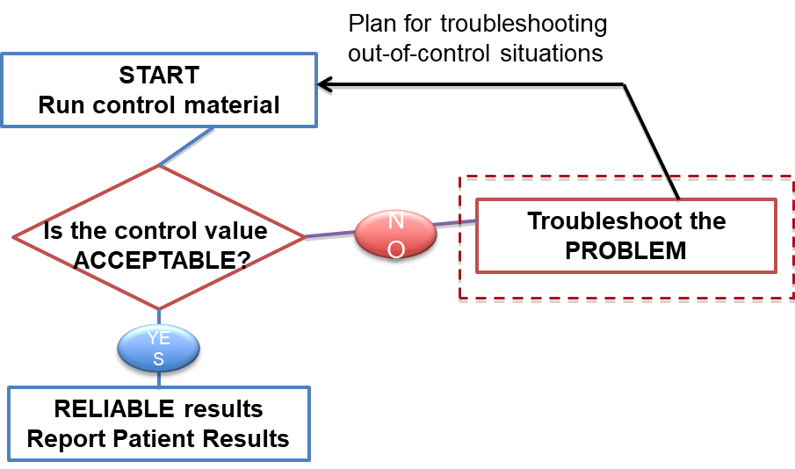
How to respond to an out-of-control QC
Stop reporting patient results
Investigate and troubleshoot
Verify that patient results were not compromised
Address patient results that were compromised

Slide 37

Investigation and troubleshooting: repeat
QC is Rejected
Repeat QC
Rejected again
Repeat QC
Rejected again
Repeat QC
Investigate
Identify type of errors
Systematic Error
Random Error
Start with simple and easy to solve potential causes
Right reagents?
New Calibration?
Work through the difficult potential causes
Instrument maintenance
Modification from last troubleshooting
New lot of QC?
Expired reagents?
Any changes since last acceptable QC?
Degradation of reagents

Slide 38
How to address impacted patient results
Criteria for correction – determine clinical significance of impact
Total allowable error
Medical requirements
Professional organizations/accrediting agencies
In the US, result correction entails calling/informing clinicians about the change
If result patient retesting is not possible because of stability (or other) issues, result correction still needs to occur
Report results as invalid and inform clinicians

Slide 39
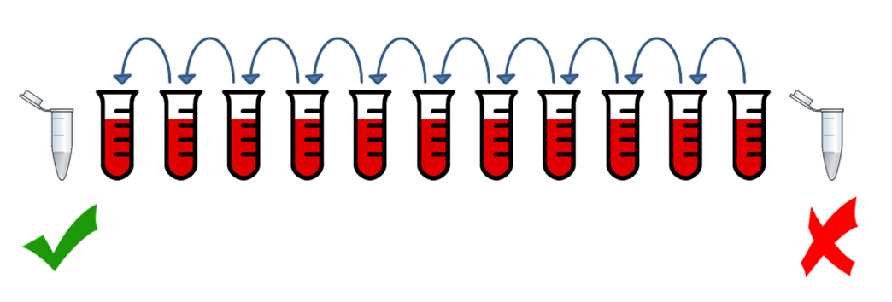
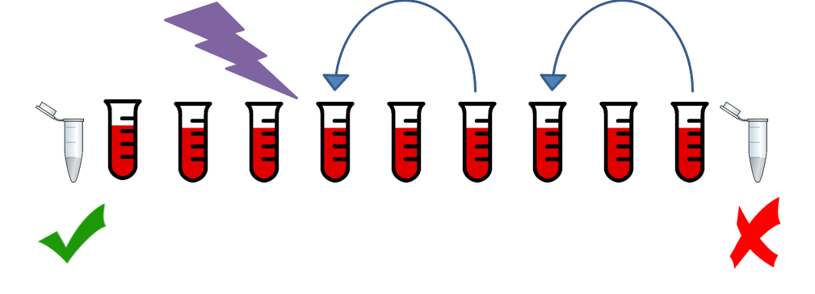
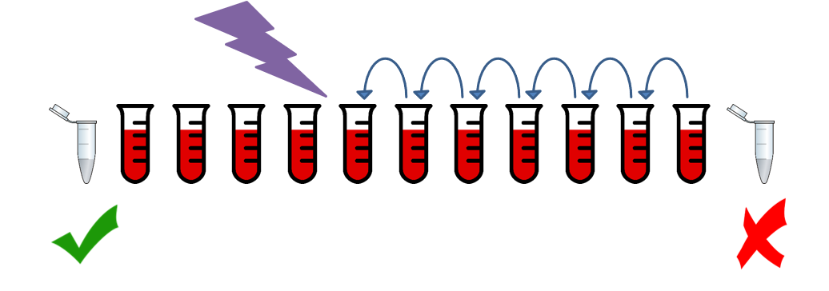
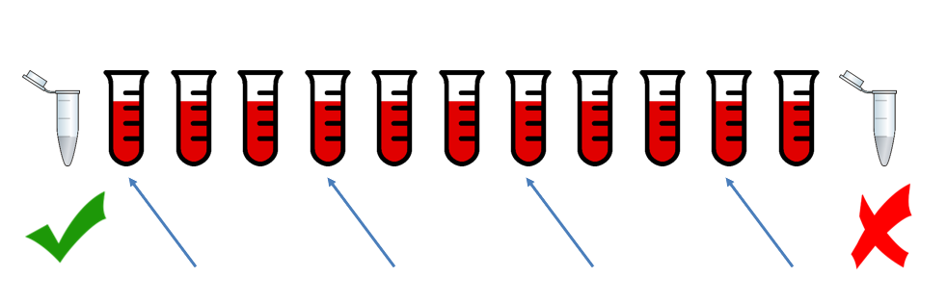
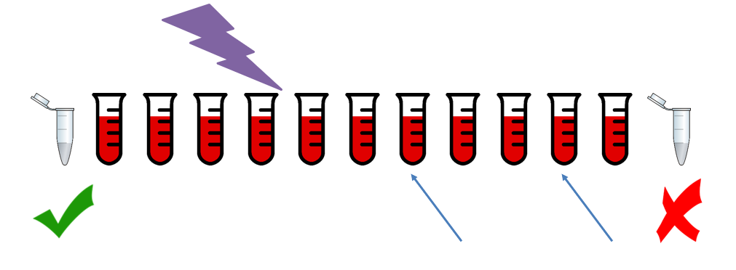
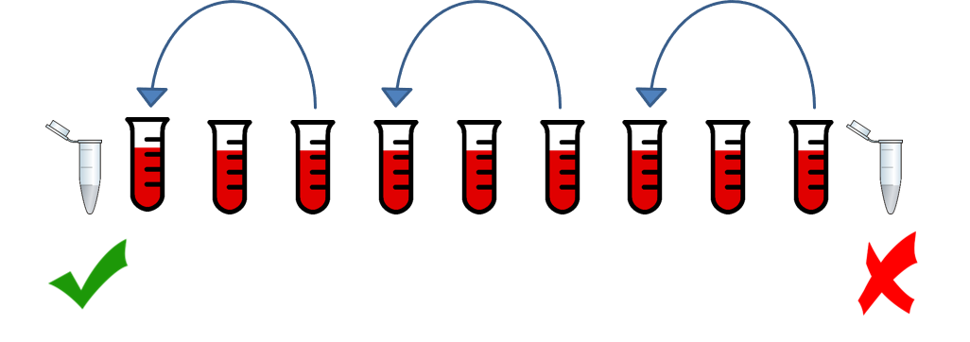
How to identify extent of impact on patient results?
Test every patient until last good QC
Test patients in batches until point of error
Test every patient until point of error
Test patients in intervals until last good QC
Ensure that system is now in control or retest patient specimens on a different instrument
Test patients in batches until last good QC
Test patients in intervals until point of error

Slide 40
QC limitations
Noncommutability
QC materials may not behave like real patient specimens
Lowers sensitivity and specificity of error detection
A snapshot of moment
Assumes method remains stable between QC events
Does not monitor performance in real-time
Expensive
Large proportion of total testing cost
Does not challenge the entire testing process

Slide 41
QC limitation: snapshot of a moment
1st Shift
2nd Shift
3rd Shift
QC
QC
QC
L1/L2
L1/L2
L1/L2
QC
QC
QC
QC
QC
QC
QC results
Patient results

Slide 42
Patient data as QC check - moving average
QC
QC
QC
QC
QC
QC
QC results
Patient results
Moving average

Slide 43
Patient data as QC check - Delta
Difference between current and previous results within a given time.
Delta triggers investigation before patient result is reported.
Delta must balance false and true alerts.
Unlike QC, delta can detect preanalytical and postanalytical errors.

Slide 44
Questions?
Thank you

